Slide 1

Mario
Aid in the development of better public safety measures
Preparedness for adverse weather
Enhance transportation safety
US Accident Data (2016-2023) from Kaggle
Focus on Los Angeles
How do weather conditions impact accident rates in Los Angeles?
US Accidents: 7.7 million
Los Angeles: ~155K
Predictors
Temperature(F) | Wind_Direction
Wind_Chill(F) | Wind_Speed(mph)
Humidity(%) | Precipitation(in)
Pressure(in) | Weather_Condition (rain, snow, etc. – 145!)
Visibility(mi) | is_weekend
 | is_holiday

Slide 2
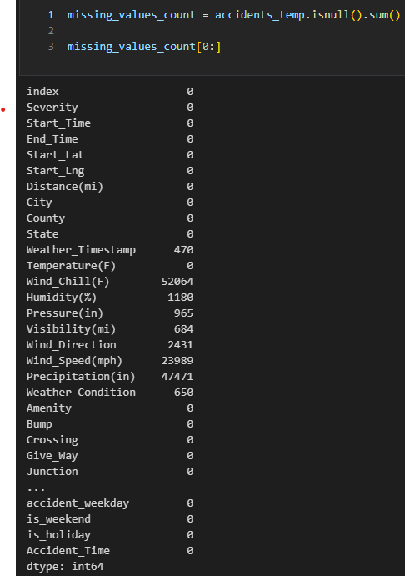
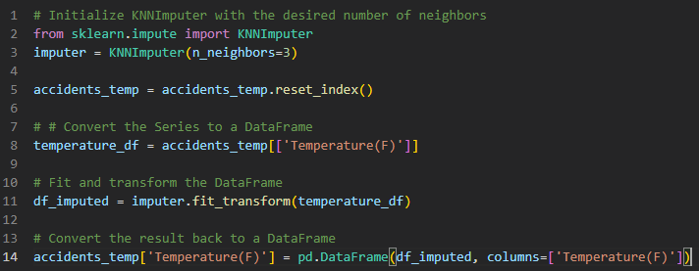
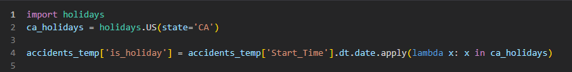
Mario
Predictors with missing data
KNN Imputer vs Rolling Average
Python library for holidays (149 countries!)

Slide 3
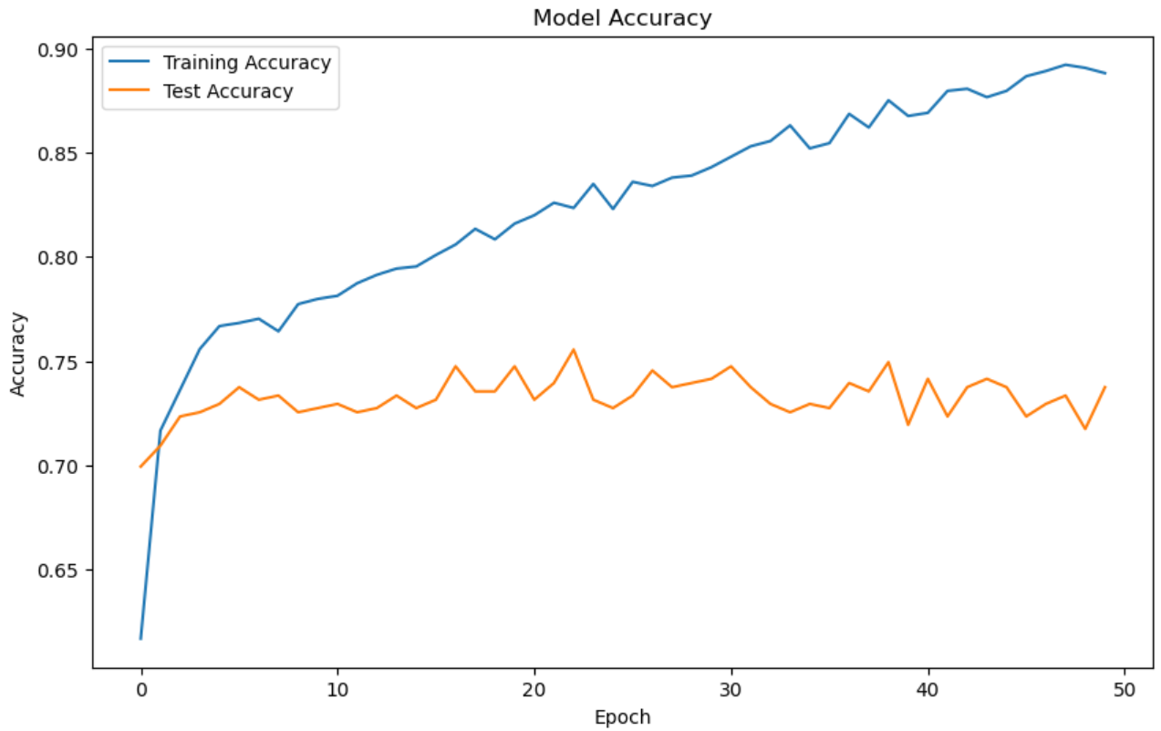
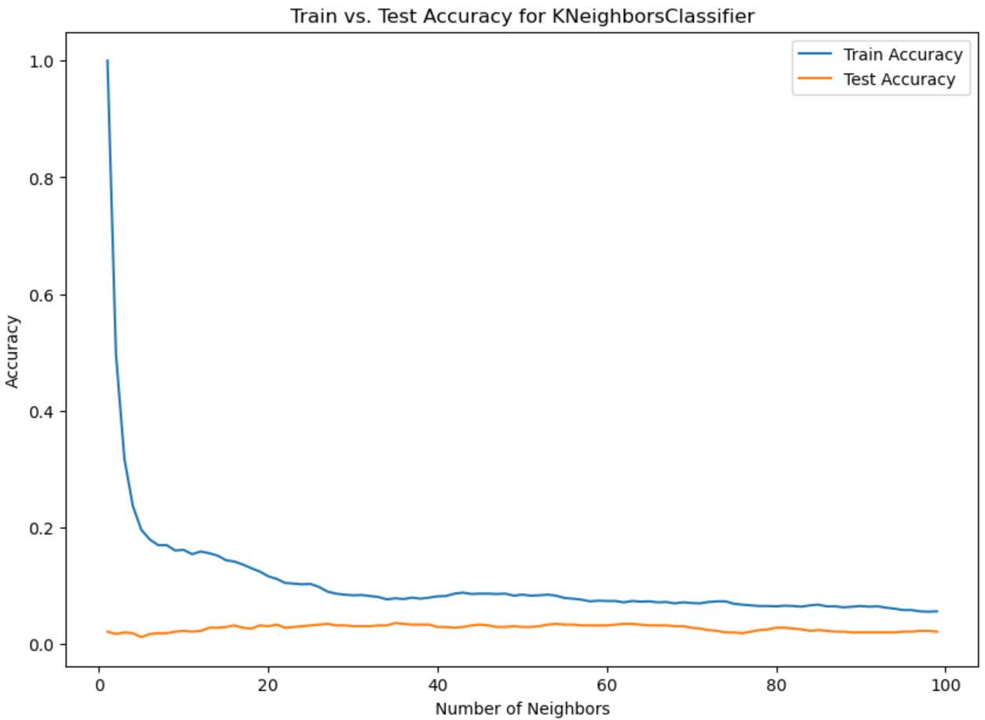
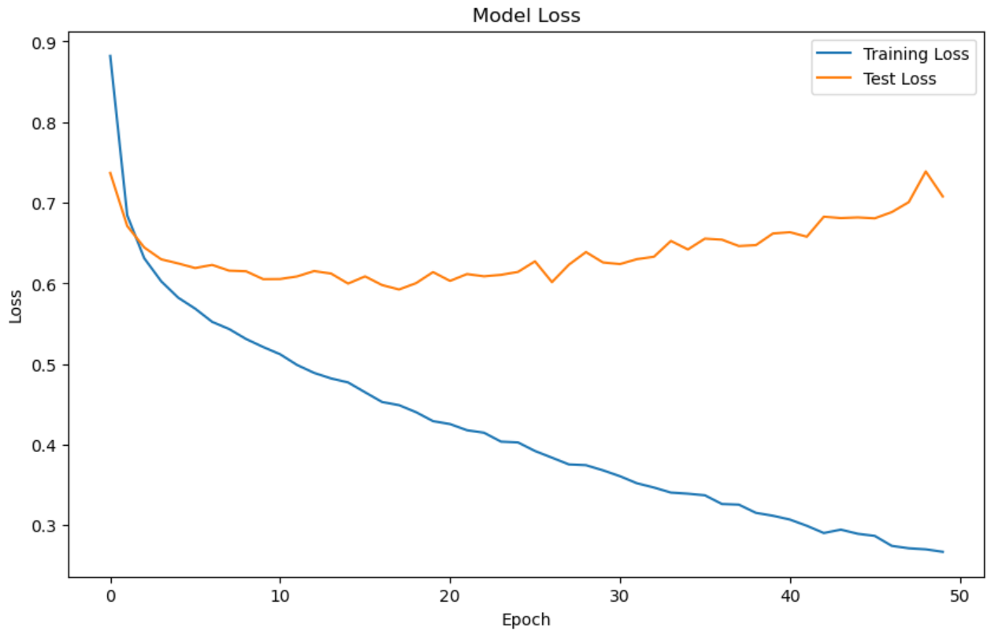
Catherine
Neural Network Model (3 classes)
K-Nearest Neighbors (KNN) Model
Best Number of Neighbors: 35 Best Test Accuracy: 3.61%
Test Loss: 0.66
Test Accuracy: 73.55%

Slide 4
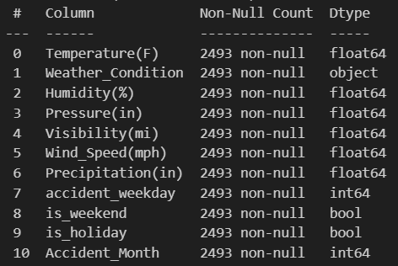
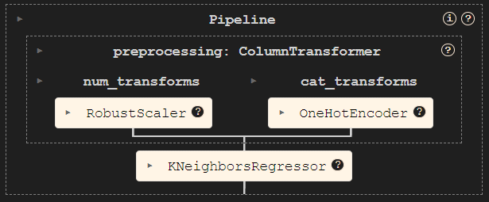
Predictors & Pipeline
Ibrahim

Slide 5
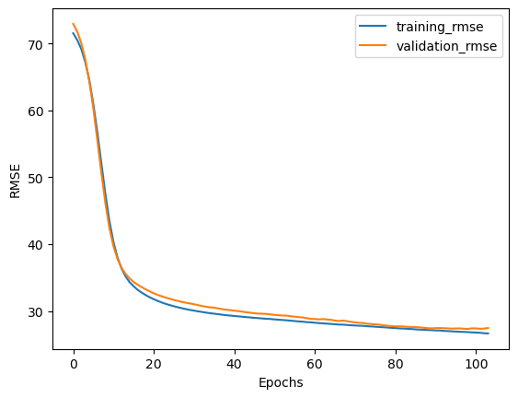
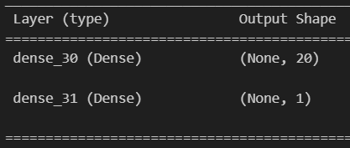
Neural Network
Ibrahim

Slide 6
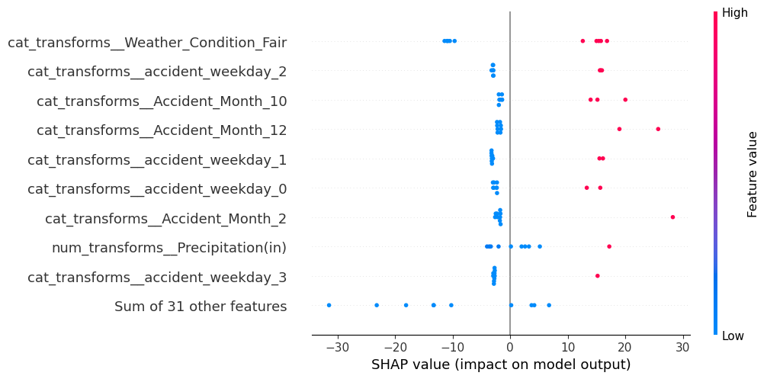
Ibrahim
SHAP Values

Slide 7
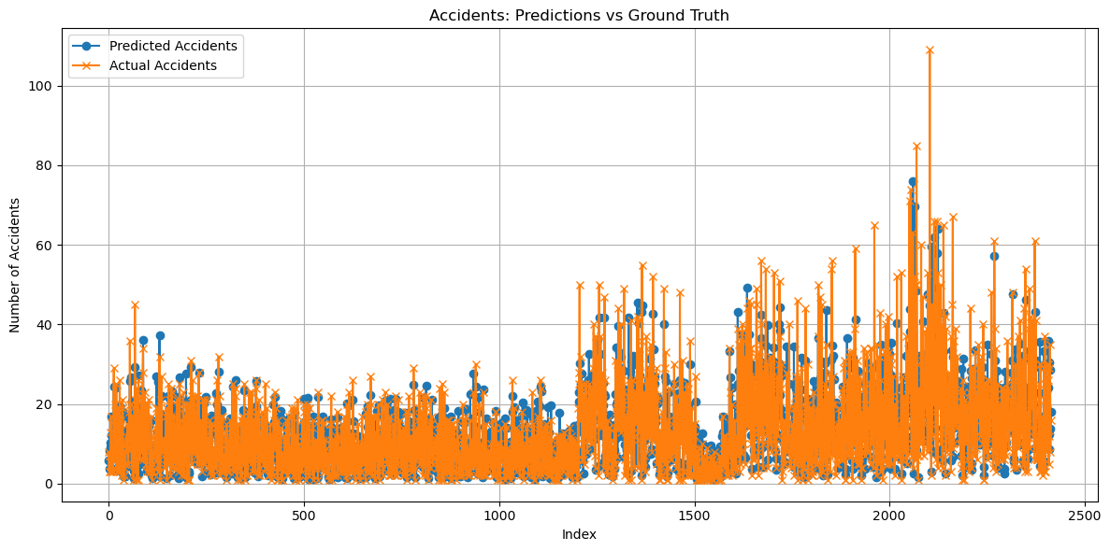
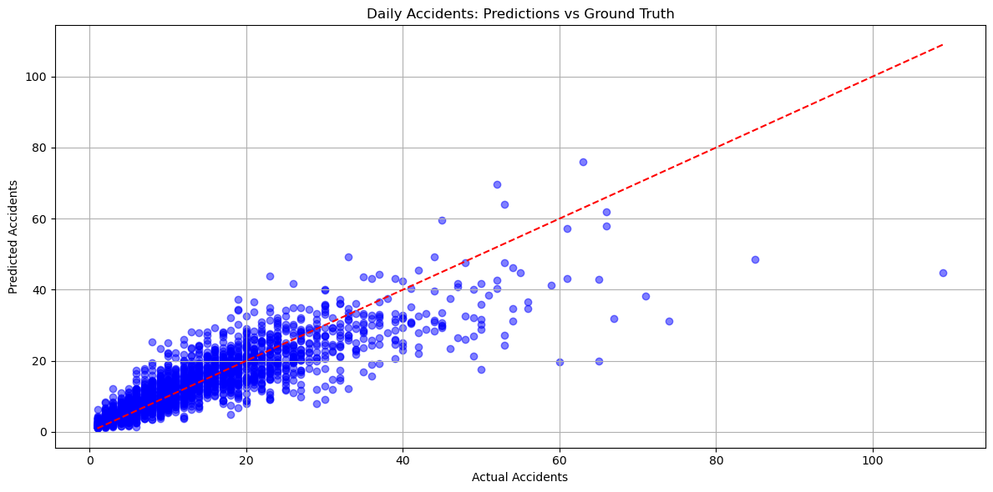
Dmytro
With hourly split:
- The base regression model showed a MAE of approximately 4.5 accidents per day on the test data.
- The random forest model slightly improved the MAE to 3.48 accidents
Outliers still distort the results.

Slide 8
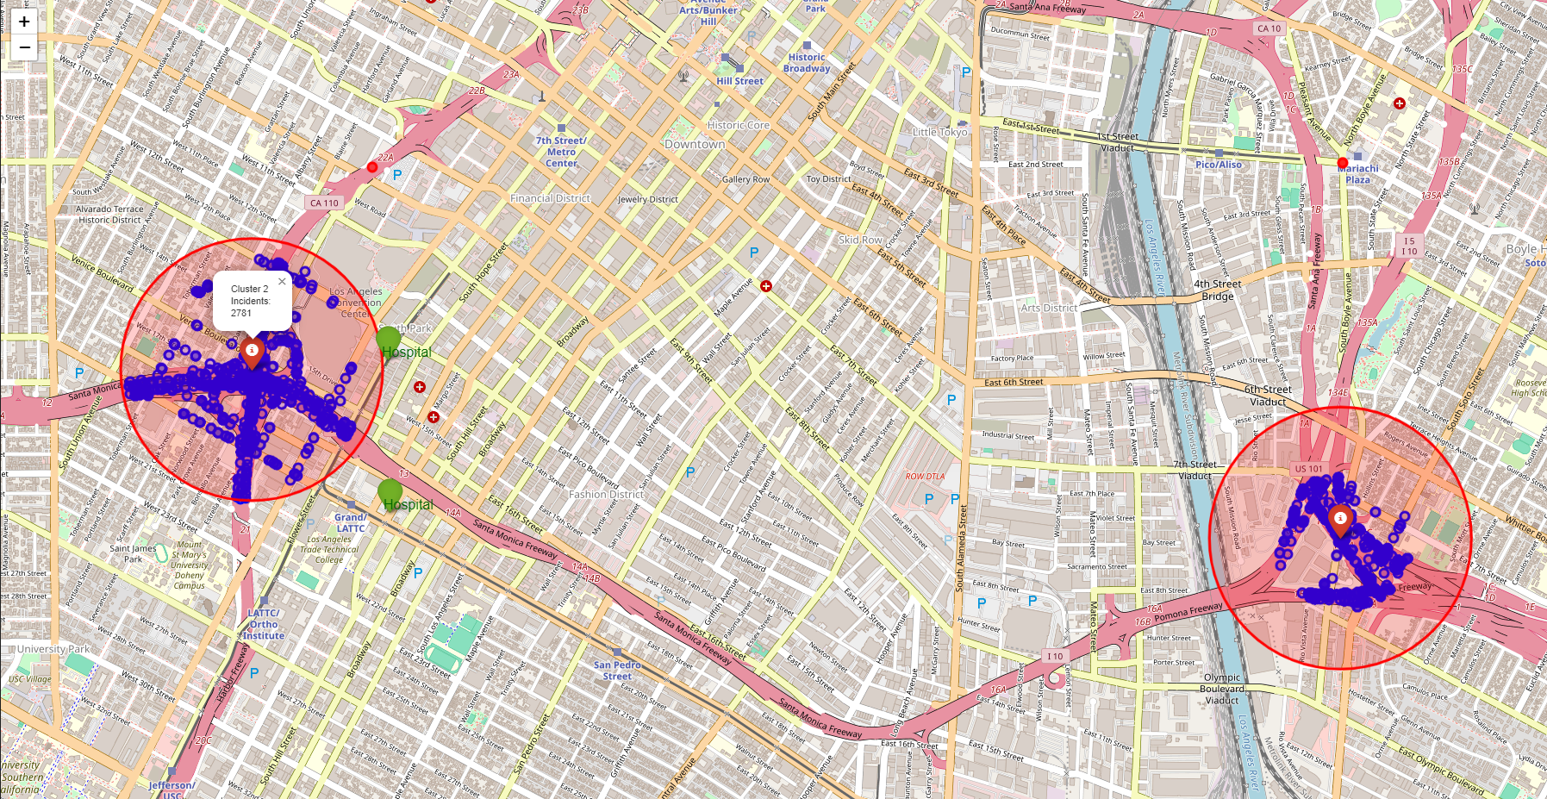
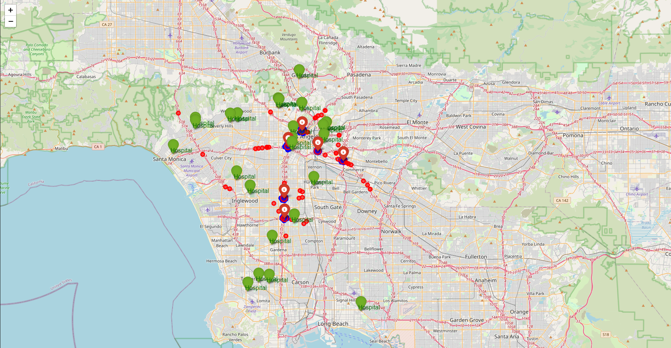
Dmytro
As a result of clustering based on density, we were able to identify and display on the map the locations where accidents occurred more frequently.
Using folium API, map representation was created.
From sklearn.cluster module was used DBSCAN Density-Based Spatial Clustering of Applications with Noise

